Slide 1

EatWise : AI-Based Food Expiry, Usage & Nutrition Optimizer
Category: Software
SDG: Goal 12- Responsible Consumption and Production
Group Number: 14
Group Members: Aditi Gujar, Vaishnavi Bagmar, Karina Jain, Saniya Dhopavkar
Guide: Dr. Mahesh Pawaskar

Slide 2
Presentation Outline:
Introduction & SDG mapped
Literature Survey
Limitations in Existing Systems
Problem Statement
Proposed Solution & Structure
Experimental Setup
Implementation
Conclusion
Research & References

Slide 3
Introduction:
EatWise is an AI-based smart food management app designed to reduce food waste and improve healthy eating habits.
It helps users track food expiry, nutrition, and allergens using barcode scanning or manual entry.
The app gives personalized food suggestions based on user goals like weight gain, weight loss, or maintenance.
EatWise predicts which food should be used first and sends expiry and usage alerts to avoid wastage.
The system supports the theme “Responsible Consumption and Production” by promoting sustainable food practices.

Slide 4

Sustainable Development Goal:
This project contributes to SDG Goal 12 (Responsible Consumption and Production) by reducing food waste and encouraging smarter food usage through digital technology. EatWise uses barcode scanning, expiry tracking, and nutrition analysis to help users make informed food choices and avoid unnecessary wastage.
By providing real-time alerts, usage priority, and health-based recommendations, the system promotes responsible consumption habits at the household and restaurant level. The project supports sustainable resource use by minimizing waste of food, water, energy, and money, while encouraging a more conscious and efficient food management system.

Slide 5
Literature Survey:
Authors/ Years | Techniques/ Methods | Key Points
Sneha Chauhan et al., NCAIDT 2025 | Web-based food inventory tracking; AI for expiry prediction; AI recipe suggestion; role-based access control | Developed a scalable web platform for intelligent food tracking and recipe suggestions; uses AI to predict shelf life and provide personalized suggestions to reduce food waste; includes household, business, and admin roles; integrates React.js, Laravel, MySQL and Python modules.
Helen Onyeaka et al., Journal of Agriculture and Food Research 2025 | AI techniques including machine learning, predictive analytics for food spoilage prediction | Reviews the application of AI models to predict food spoilage and reduce food waste; highlights early detection systems and dynamic algorithms; discusses successful industry cases (Shelf Engine, Afresh, IKEA) showing significant waste reduction, while noting challenges in data quality and integration.
Khuram Shehzad, Global Trends in Science and Technology 2025 | AI predictive models (ML, deep learning), sensors, spectroscopy, environmental data for spoilage estimation | Presents AI-driven predictive models to estimate food spoilage based on factors like temperature and humidity; discusses use of CNN, regression, and hybrid models for improved shelf-life estimation; identifies challenges like limited data, model accuracy, and high implementation cost.

Slide 6
Limitations of existing systems :
MyFitnessPal Focuses mainly on calorie and macro tracking. Does not track food expiry. Does not help in reducing food waste.
Yuka Scans food and gives health scores. Does not consider user goals like weight gain or loss. Does not track expiry or inventory.
Out of Milk Helps manage shopping lists and pantry. Does not analyze nutrition. Does not suggest food based on health needs.

Slide 7
Problem Statement:
Food waste occurs due to poor expiry tracking and lack of awareness about food freshness and nutrition. A smart system like EatWise helps manage food inventory, track expiry, and promote healthier consumption while reducing waste.

Slide 8
Proposed Methodology :
Technologies Used:
Python: Backend
Open CV: Image processing and barcode scanning
Scikit learn : spoilage prediction models
OpenAI API : AI chatbot for nutrition assistance
Methodology:
User logs groceries via barcodes scan or manual entry.
Food data stored in database.
AI model predicts expiry urgency.
System prioritizes food usage order.
Dashboard displays alerts, recipes, and suggestions.

Slide 9
Experimental Setup :
Development Environment: The frontend of EatWise is developed using Flutter in VS Code, while the backend uses Supabase for authentication and data storage.
Hardware Requirements:
Laptop/PC for development
Software Requirements:
Flutter SDK
Dart SDK
Supabase account
Web browser (for testing/demo)
Barcode & Manual Entry Module: The system accepts product data through barcode scanning or manual barcode entry for food identification.

Slide 10
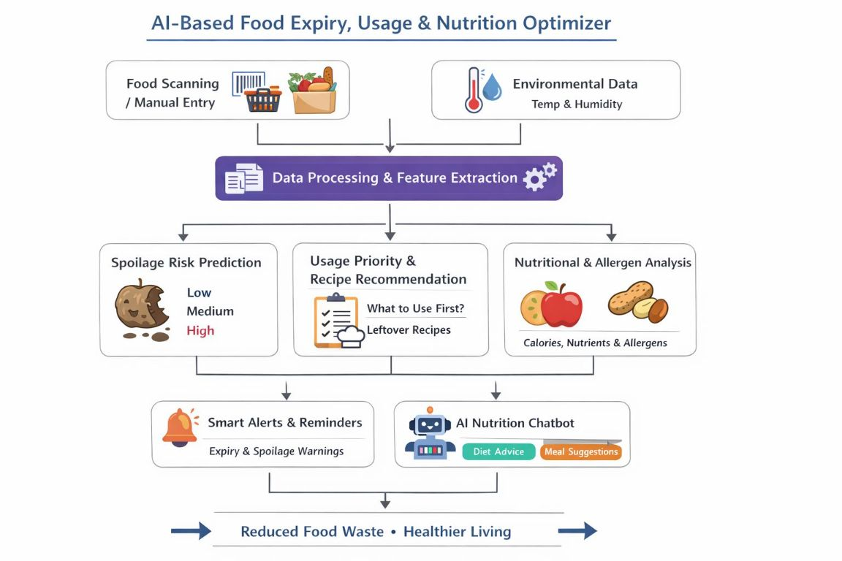
System Design:

Slide 11
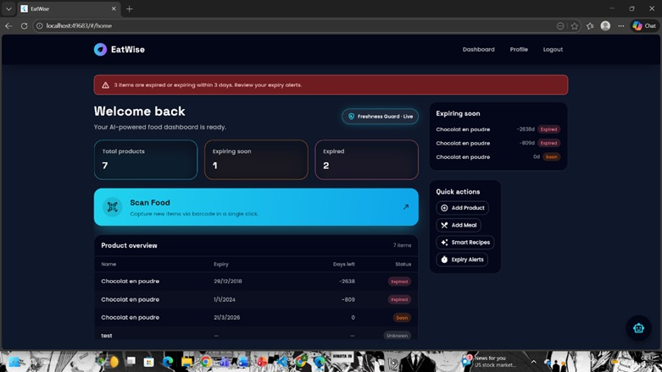
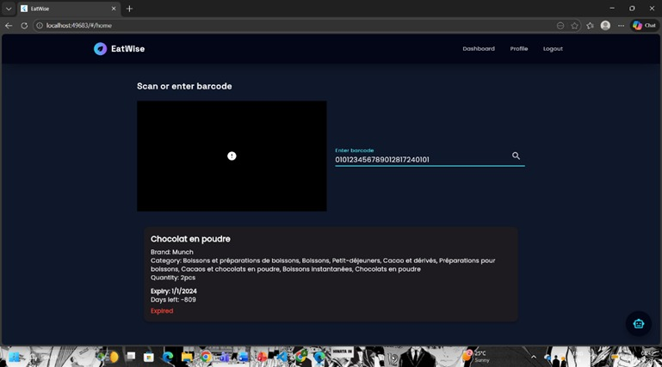
Implementation :
Fig no. 1 : Login Page
Fig no. 2 : Barcode entry Page

Slide 12
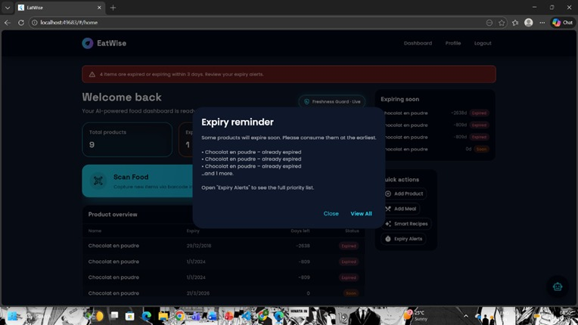
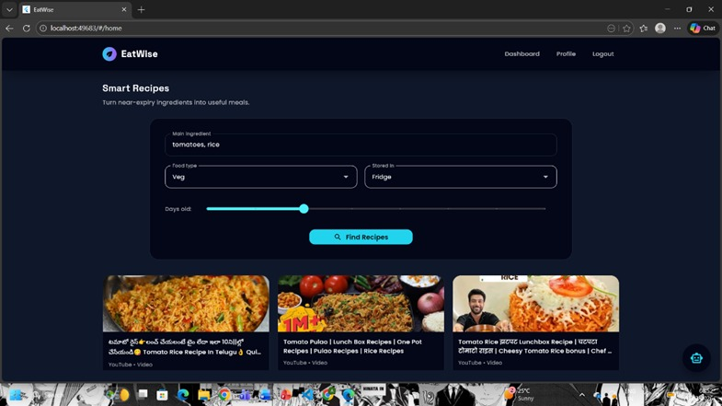
Fig no. 3 : Expiry Reminder
Fig no. 4 : Smart Recipe Recommendation

Slide 13
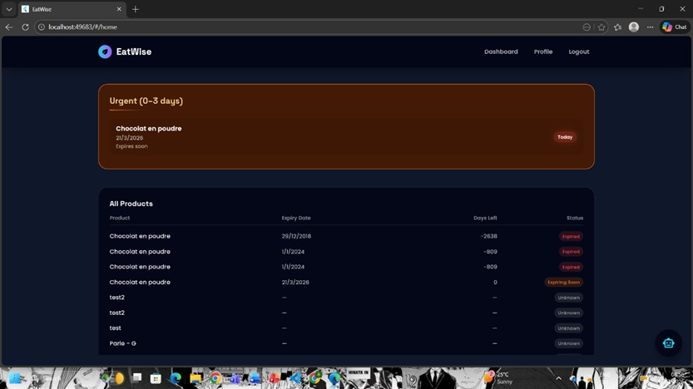
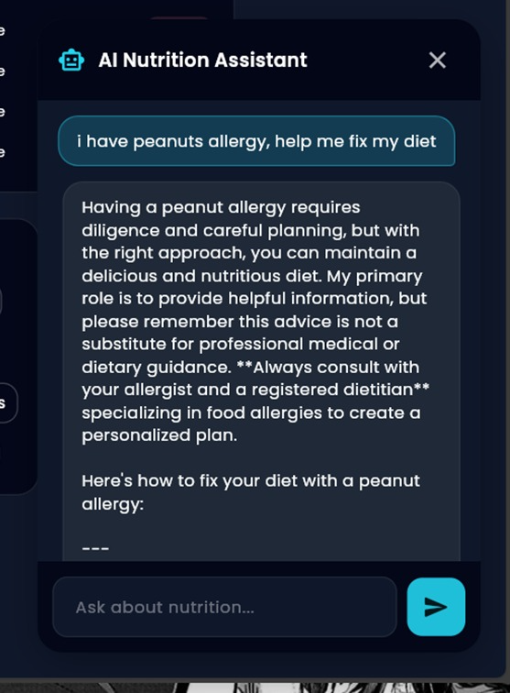
Fig no. 5 : Food Prioritization
Fig no. 6: AI Nutritionist Chatbot

Slide 14
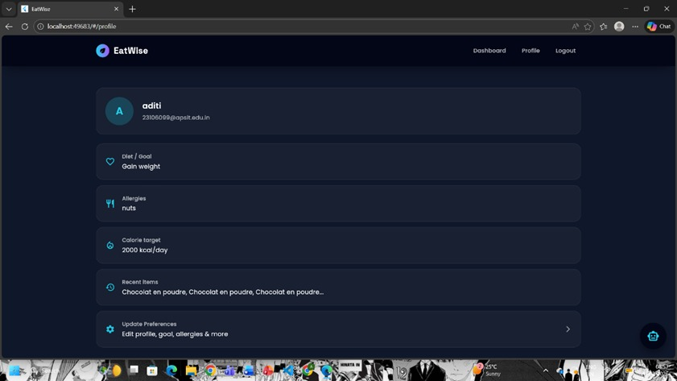
Fig no.7: User’s Profile

Slide 15
Conclusion:
EatWise provides a smart and practical solution to reduce food waste and promote healthy eating habits.
By combining barcode-based food tracking, expiry monitoring, and nutrition analysis, the app helps users make better food choices.
It supports sustainable living by encouraging responsible consumption and efficient food management.
EatWise shows how technology can be used to solve real-world problems in a simple and effective way.

Slide 16
Future Scope :
Convert EatWise into a full mobile app for Android and iOS.
Enable real-time notifications for food expiry reminders.
Allow direct camera barcode scanning in the mobile version.

Slide 17
Research & References:
[1] S. Chauhan et al., “AI Food Expiry Tracker and Smart Recipe Suggestion,” Proceedings of NCAIDT 2025, 2025. [Online]. Available: https://ncaidt.ganitara.com/ncaidt25/papers/P5.pdf
[2] H. Onyeaka et al., “Artificial intelligence in food system: Innovative approach to minimizing food spoilage and food waste,” Journal of Agriculture and Food Research, vol. X
[3] X, 2025. [Online]. Available: https://www.sciencedirect.com/science/article/pii/S2666154325002662

